Slide 1


DYNAMIC PRICING
DASHBOARD
FRONT-END ENGINEERING & FRAMEWORK DESIGN PROJECT
2027

Slide 2

ABSTRACT
HE DYNAMIC PRICING DASHBOARD IS A WEB-BASED APPLICATION THAT AUTOMATICALLY ADJUSTS PRODUCT PRICES BASED ON FACTORS SUCH AS DEMAND, STOCK AVAILABILITY, AND MARKET TRENDS. THE SYSTEM PROVIDES REAL-TIME PRICE RECOMMENDATIONS AND VISUAL ANALYTICS THROUGH AN INTERACTIVE DASHBOARD. BUILT USING REACT, JAVASCRIPT, HTML, CSS, AND LOCAL STORAGE, THE PROJECT DEMONSTRATES MODERN FRONT-END ENGINEERING CONCEPTS WHILE IMPROVING PRICING EFFICIENCY AND BUSINESS DECISION-MAKING.

Slide 3

PROBLEM STATEMENT
TRADITIONAL PRICING METHODS RELY HEAVILY ON MANUAL DECISIONS, LEADING TO:
REVENUE LOSS DUE TO INCORRECT PRICING
SLOW RESPONSE TO MARKET CHANGES
INVENTORY MANAGEMENT ISSUES
LACK OF REAL-TIME ANALYTICS
DIFFICULTY IN TRACKING PRICING HISTORY
A DYNAMIC PRICING SOLUTION IS NEEDED TO AUTOMATE PRICING DECISIONS AND IMPROVE BUSINESS PERFORMANCE.

Slide 4
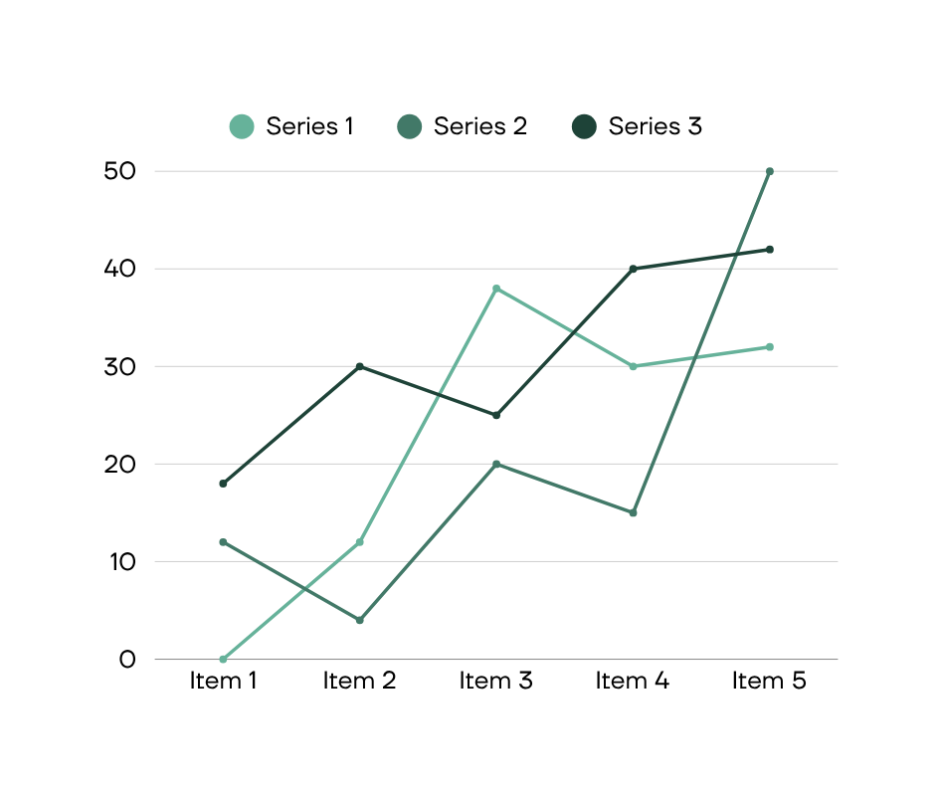
OBJECTIVES
PRIMARY OBJECTIVES
DEVELOP A RESPONSIVE PRICING DASHBOARD
IMPLEMENT DYNAMIC PRICING ALGORITHMS
STORE AND MANAGE PRODUCT DATA USING LOCAL STORAGE
VISUALIZE PRICING TRENDS AND ANALYTICS
IMPROVE USER EXPERIENCE THROUGH REACT COMPONENTS
EXPECTED OUTCOMES
BETTER PRICING DECISIONS
IMPROVED INVENTORY CONTROL
ENHANCED BUSINESS ANALYTICS

Slide 5
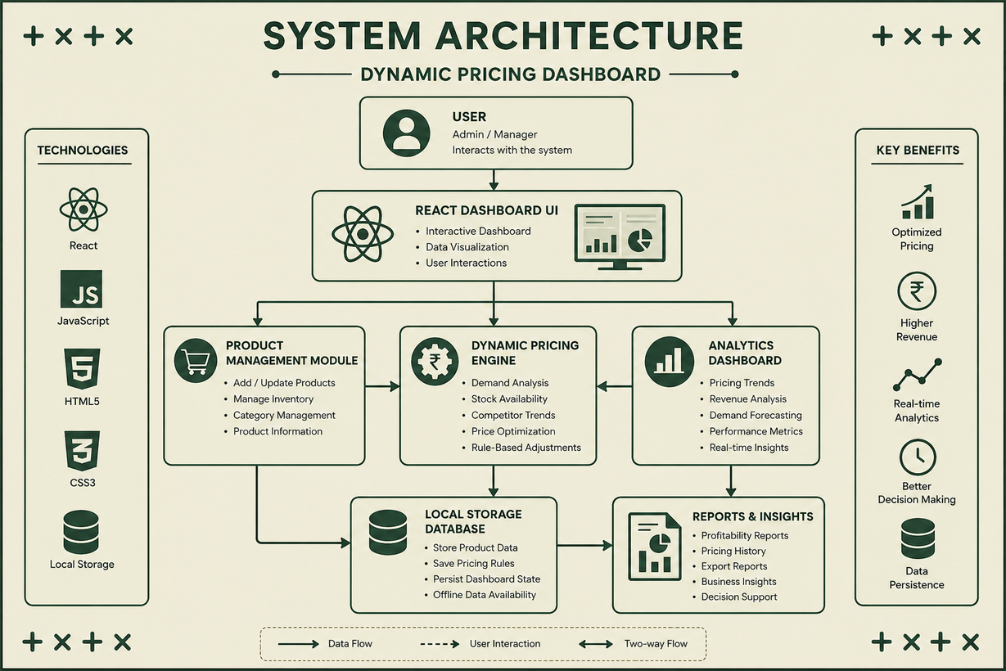
SYSTEM ARCHITECTURE
USER INTERFACE (REACT)
↓
PRODUCT MANAGEMENT MODULE
↓
PRICING ENGINE
↓
LOCAL STORAGE DATABASE
↓
ANALYTICS DASHBOARD
↓
REPORTS & VISUALIZATIONS

Slide 6
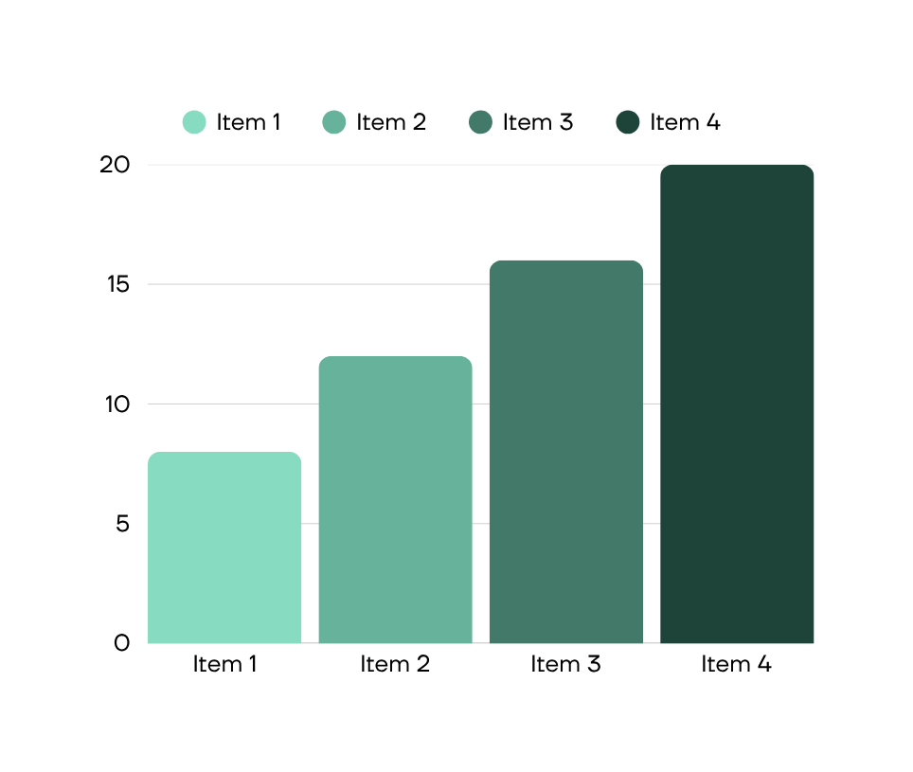
MODULE DESCRIPTION
1. USER MANAGEMENT
LOGIN AND AUTHENTICATION
USER PROFILE MANAGEMENT
2. PRODUCT MANAGEMENT
ADD PRODUCTS
UPDATE PRODUCTS
DELETE PRODUCTS

Slide 7

3. PRICING ENGINE
DEMAND-BASED PRICING
STOCK-BASED PRICING
PRICE ADJUSTMENT RULES
4. ANALYTICS MODULE
REVENUE ANALYSIS
PRICING TRENDS
PERFORMANCE REPORTS

Slide 8

TECHNOLOGIES USED
FRONT-END:
REACT JS
HTML5
CSS3
JAVASCRIPT ES6
DATA STORAGE:
BROWSER LOCAL STORAGE
DEVELOPMENT TOOLS
VS CODE
VITE
GIT & GITHUB

Slide 9


THYNK
UNLIMITED
FUTURE ENHANCEMENTS
FUTURE SCOPE
BACKEND INTEGRATION USING NODE.JS
DATABASE SUPPORT (MONGODB/MYSQL)
AI-BASED PRICE PREDICTION
REAL-TIME MARKET API INTEGRATION
USER ROLE MANAGEMENT
CLOUD DEPLOYMENT
ADVANCED ANALYTICS DASHBOARD

Slide 10

CO1 CONCEPTS USED
CONCEPTS APPLIED:
COMPONENT-DRIVEN ARCHITECTURE
VIRTUAL DOM
UNIDIRECTIONAL DATA FLOW
REUSABLE REACT COMPONENTS
RESPONSIVE UI DESIGN
IMPLEMENTATION:
THE DASHBOARD IS DIVIDED INTO INDEPENDENT REACT COMPONENTS SUCH AS PRODUCT LIST, ANALYTICS PANEL, PRICING MODULE, AND DASHBOARD CARDS.

Slide 11
CO2 CONCEPTS USED
JAVASCRIPT & TYPESCRIPT ENGINEERING
CONCEPTS APPLIED
ES6 FEATURES
ARROW FUNCTIONS
CLOSURES
ASYNC PROGRAMMING
MODULAR JAVASCRIPT
IMPLEMENTATION
JAVASCRIPT HANDLES DYNAMIC PRICING CALCULATIONS, EVENT HANDLING, DATA UPDATES, AND LOCAL STORAGE OPERATIONS.

Slide 12
CO3 CONCEPTS USED
REACT COMPONENT MODEL
CONCEPTS APPLIED
PROPS
STATE
HOOKS
COMPONENT COMPOSITION
CONTROLLED COMPONENTS
IMPLEMENTATION
REACT STATE MANAGES PRODUCT INFORMATION AND PRICING UPDATES WHILE HOOKS SIMPLIFY STATE MANAGEMENT.

Slide 13
CO4 CONCEPTS USED
STATE ARCHITECTURE & API INTEGRATION
CONCEPTS APPLIED
STATE LIFTING
CONTEXT MANAGEMENT
DERIVED STATE
DATA PERSISTENCE
ASYNC FLOW CONTROL
IMPLEMENTATION
LOCAL STORAGE IS USED TO MAINTAIN PRODUCT DATA, ENSURING PERSISTENCE EVEN AFTER PAGE REFRESH.

Slide 14
CO5 CONCEPTS USED
ROUTING, FORMS, ACCESSIBILITY & PERFORMANCE
CONCEPTS APPLIED
FORM VALIDATION
ACCESSIBILITY STANDARDS
KEYBOARD NAVIGATION
RESPONSIVE FORMS
PERFORMANCE OPTIMIZATION
IMPLEMENTATION
INPUT FORMS VALIDATE PRODUCT DETAILS BEFORE UPDATING PRICING INFORMATION.

Slide 15
CO6 CONCEPTS USED
BUILD SYSTEMS, TESTING & DEPLOYMENT
CONCEPTS APPLIED
VITE BUILD TOOL
PROJECT STRUCTURE
CODE OPTIMIZATION
ESLINT STANDARDS
DEPLOYMENT READINESS
IMPLEMENTATION
THE PROJECT FOLLOWS MODULAR FOLDER STRUCTURES AND OPTIMIZED REACT DEVELOPMENT PRACTICES.

Slide 16
CONCLUSION:
The Dynamic Pricing Dashboard successfully demonstrates the practical implementation of modern Front-End Engineering concepts. The project integrates React architecture, state management, dynamic pricing logic, and data persistence using Local Storage. It provides an efficient, scalable, and user-friendly solution for price optimization and business analytics.
Thank You

Slide 17
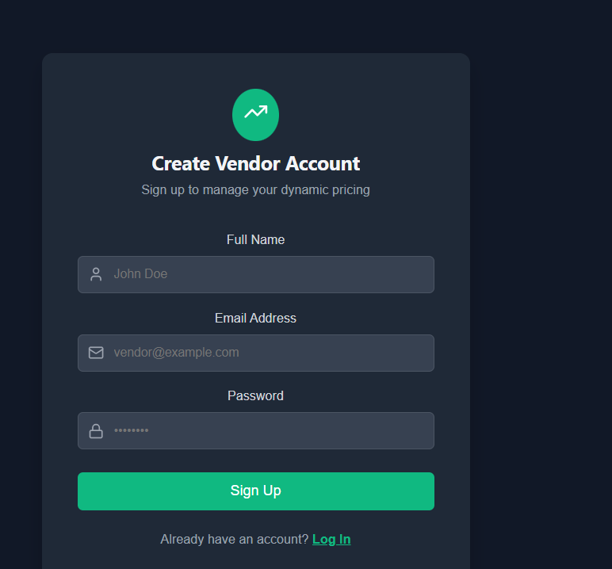
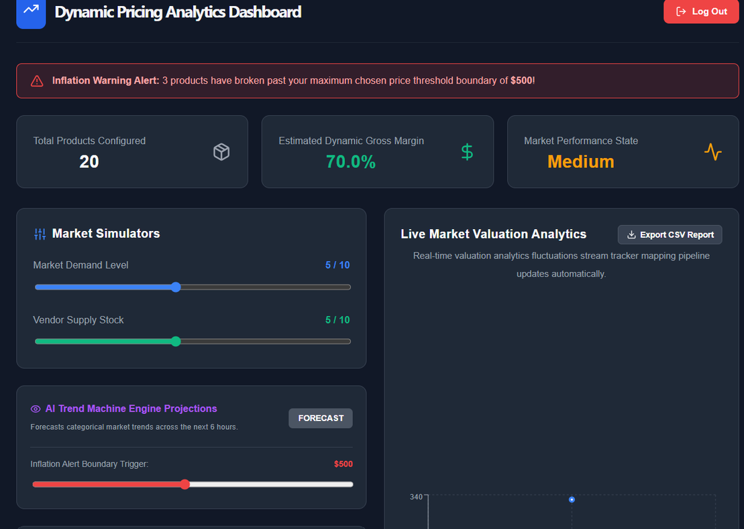
WEBSITE SCREENSHOTS:

